Slide 1
Accounting Information and its Application - Accounting Principles
2022. 5.
Yangin Yoon

Slide 2
Agenda
Recap the previous class
Financial Ratio
Stock Price and Netincome
Auditor’s Report

Slide 3
Recap the previous class (Equity)
Equities are increased with following events:
1) Establishing a company
2) Making a positive profit (net-income)
2021.1.2. (example)
Cash $10,000
Capital Stock $10,000
2021.12.31. (example)
Revenue $10,000
Interest Income $200
Cost of Goods $6,800
Salary Expense $2,000
Retained Earning $1,400

Slide 4
Recap the previous class (Equity)
Equities are decreased with following events:
1) Providing dividends
2) Reporting a loss (net-income)
2022.2.20. (example)
Retained Earning $500
Cash $500
2021.12.31. (example)
Revenue $10,000
Interest Income $200
Retained Earning $1,600
Cost of Goods $9,800
Salary Expense $2,000

Slide 5
Recap the previous class (Equity)
At the end of 2021, the total equities were $12,000. The total number of shares was 10,000.
John thought that the future of this company would be very bright. He was eager to be the shareholder of this company.
- The company offered to invest $1,500 for 1,000 shares. John agreed with it.
The company issued additional 1,000 shares and received $1,500 from John on 2022.1.3.
2022.1.3.
Cash $1,500
Capital Stock $1,000
Capital in excess of par value of stock $500
* “Capital in excess of par value of stock” is an equity type account.
“Paid-in capital in excess of par” means the same account.
https://www.sec.gov/Archives/edgar/data/37996/000003799621000012/f-20201231.htm#i50ca97c02686454fb096588b8c462fda_286

Slide 6
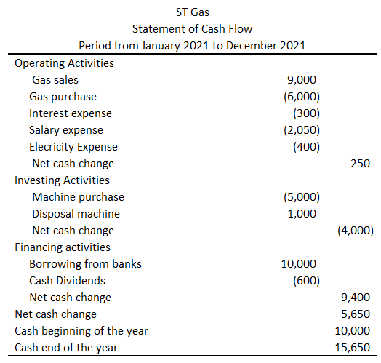
Recap the previous class (Cash Flow- Direct method)

Slide 7
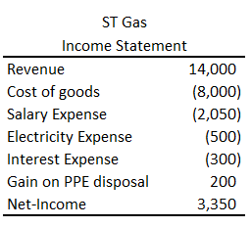
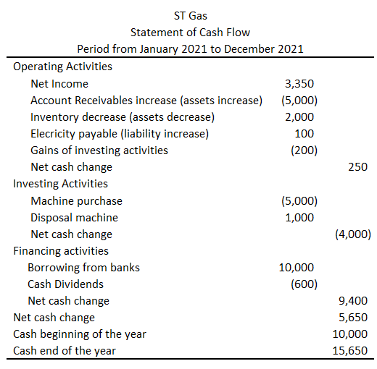
Recap the previous class (Cash Flow-indirect method)
→ Compare this with Example #1.

Slide 8
Recap the previous class (Two Types of Statement of Cash Flow)
Direct Method and Indirect Method
Direct Method
- List all the activities and their cash flow changes.
Indirect Method
- Start from the net-income
- Modifying gain and loss of investing and financial activities
- Modifying operating assets changes
- Modifying operating liabilities changes

Slide 9
Any Questions?

Slide 10
Financial Ratio
Financial ratios are calculated by using two or more than two accounts.
We can use financial ratios when we evaluate companies or compare companies each other.
The followings are the example of financial ratios:
1) Profit Margin Ratio
2) Return on Assets
3) Debt Ratio
4) And many more

Slide 11
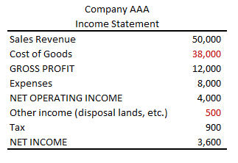
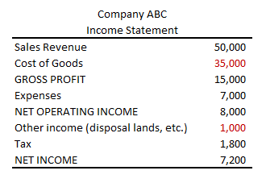
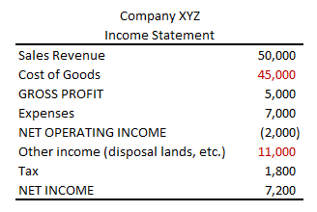

Financial Ratio - Profitability
Which company is a better one?
Profit Margin = $\frac{Net Income}{Sales}$
Gross Margin (Ratio) = $\frac{Gross Profit}{Sales}$

Slide 12
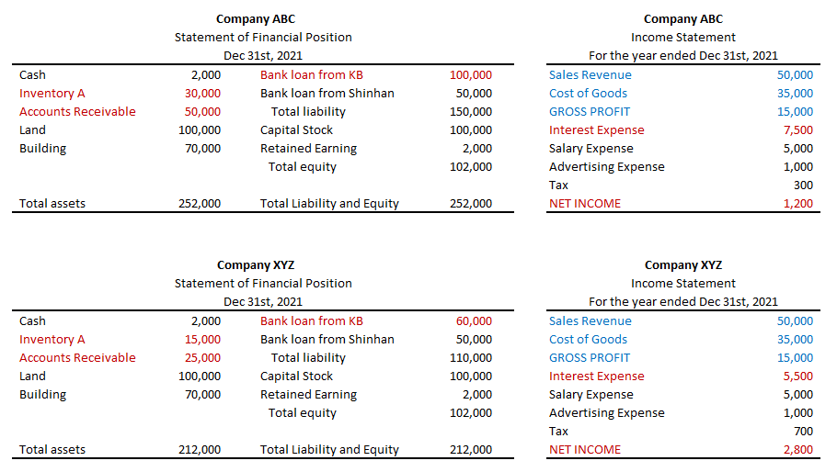
Financial Ratio – Assets turn over
Which company is a better one?

Slide 13
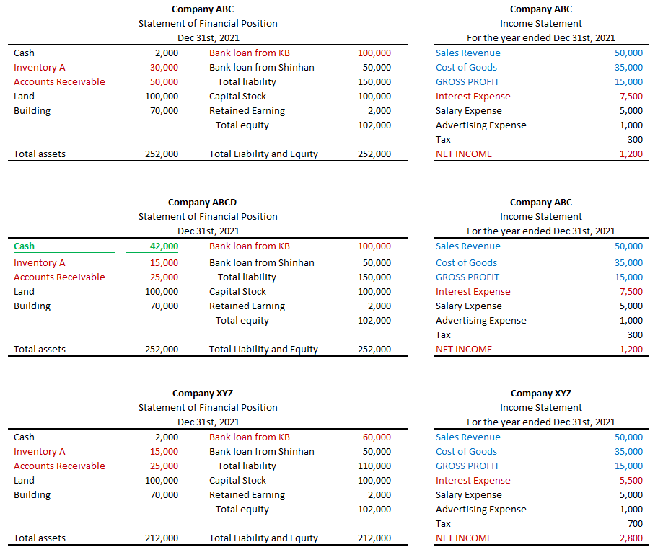
Financial Ratio - Profitability
Which company is a better one?

Slide 14
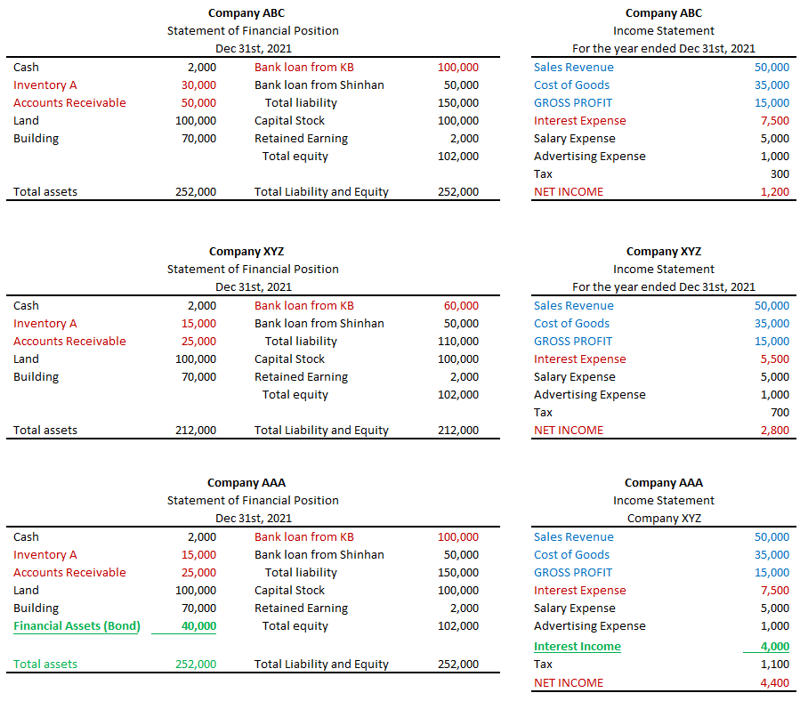
Financial Ratio - Profitability
Which company is a better one?

Slide 15

Financial Ratio - turnover
Which company is a better one?
Accounts Receivable Turnover = $\frac{Sales}{\left(Average\right) Accounts Receivable}$
Inventory Turnover = $\frac{Cost of Goods}{\left(Average\right) Inventory}$

Slide 16
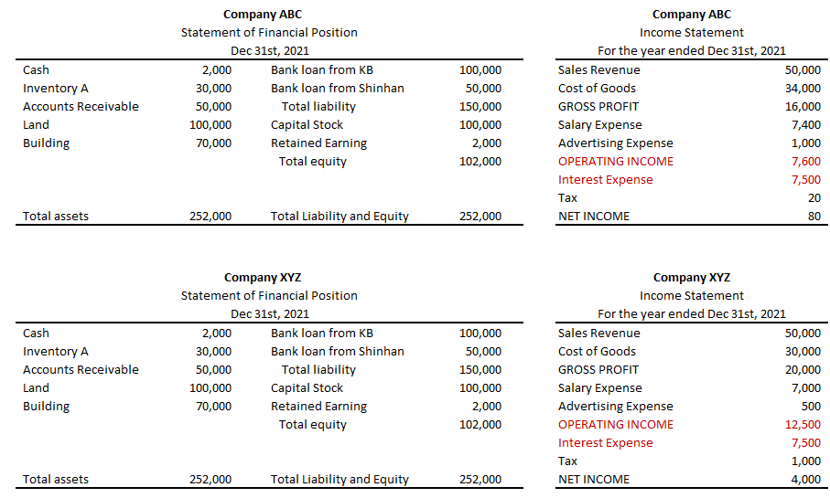

Financial Ratio – interest expense
Which company is a better one?
Times interest Earned Ratio = $\frac{Income before interest expense and taxes}{Intrest Expense}$

Slide 17
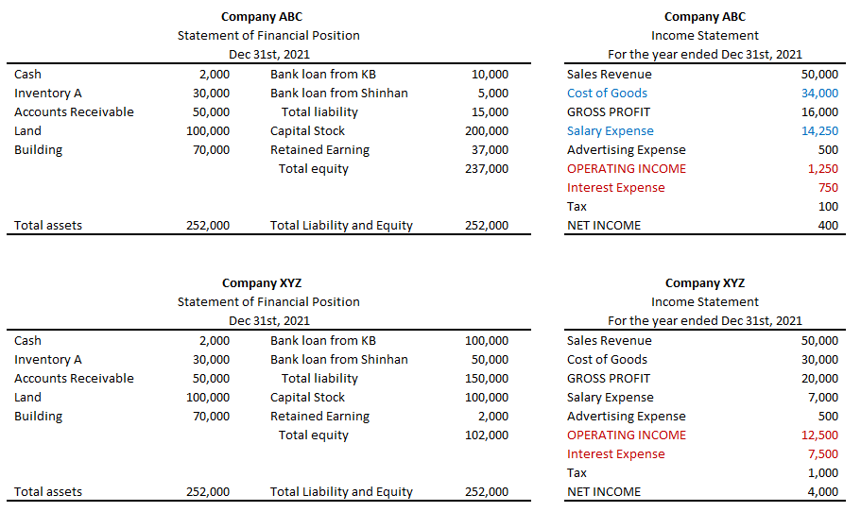
Financial Ratio – interest expense
Which company is a better one?
Times interest Earned Ratio
Profit Margin Ratio

Slide 18

Financial Ratio – Debt ratio
Which company is a better one?
Debt ratio = $\frac{Total Liabilities}{Total Assets}$
Debt-to-Equity ratio = $\frac{Total Liabilities}{Total Equity}$

Slide 19
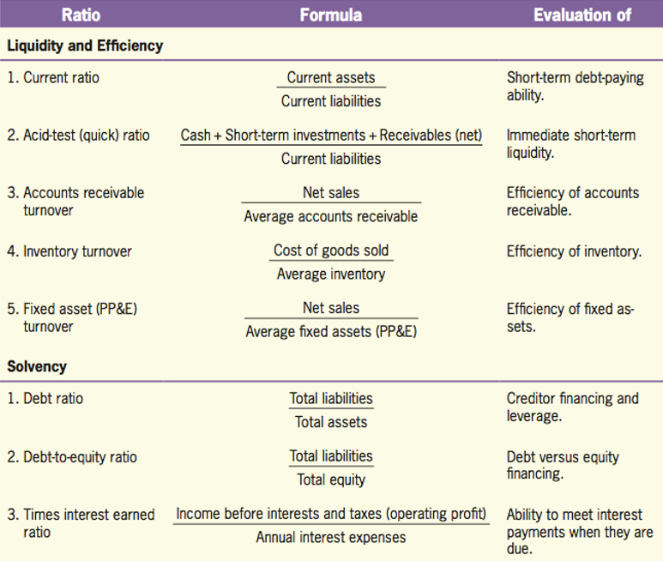
Other ratios
Financial Ratios
© 2017 Cengage Learning, Principles of Financial Accounting, 2/E (IFRS Edition)

Slide 20
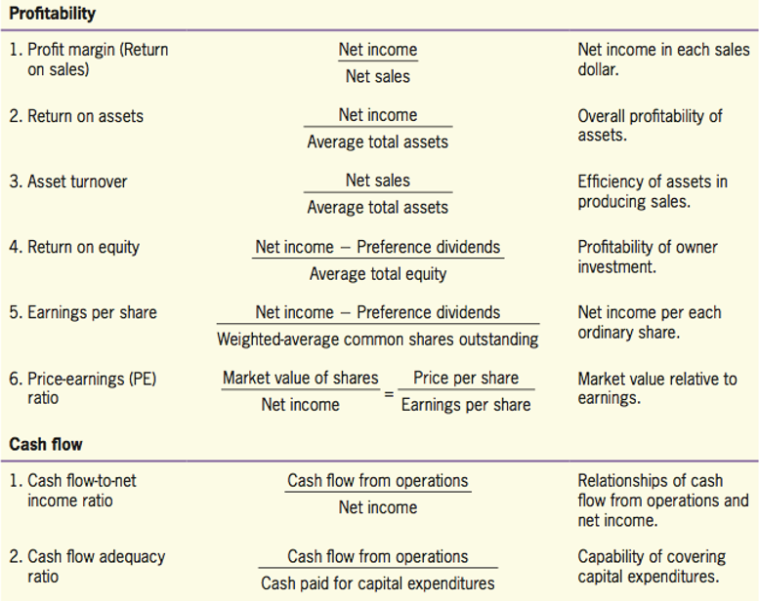
Other ratios
Financial Ratios
© 2017 Cengage Learning, Principles of Financial Accounting, 2/E (IFRS Edition)

Slide 21
Any Questions?

Slide 22
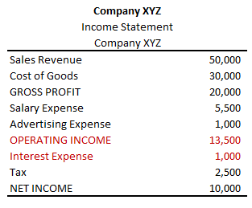

Stock Price and Net-income
Let’s assume that Company XYZ has no retained earning (providing all the annual net-income to its shareholders by dividends).
- The stock price will be the net present value of the future cash flow (The current year’s dividend was already provided.)
- The number of stocks is 1000 and the interest rate is 5%.
Price of one stock = $\frac{10}{{(1+0.05)}^{1}}$ + $\frac{10}{{(1+0.05)}^{2}}$ + $\frac{10}{{(1+0.05)}^{3}}$ + $…$
= $\frac{10}{\left(0.05\right) }$ = 2,000

Slide 23
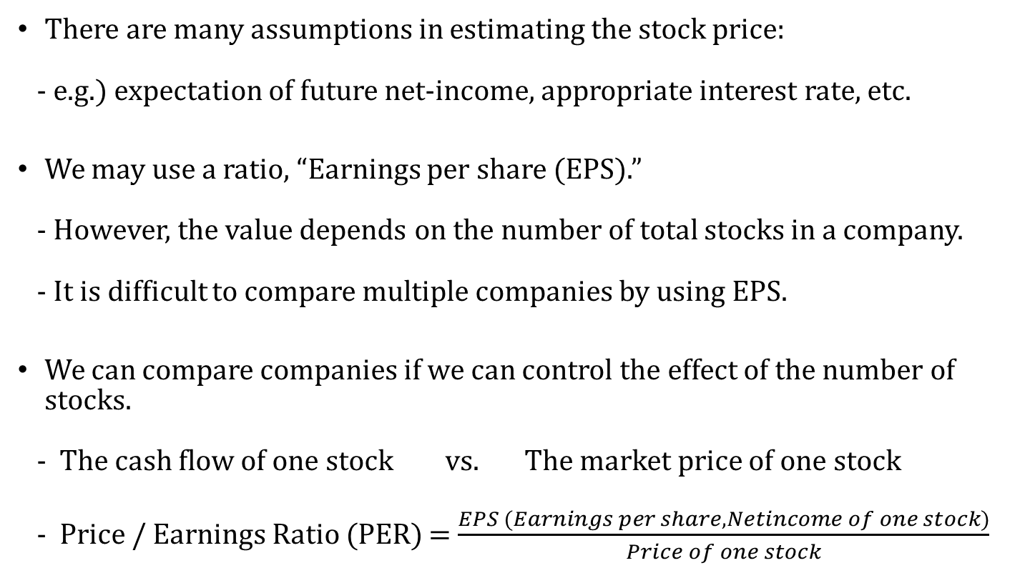
Stock Price and Net-income
There are many assumptions in estimating the stock price:
- e.g.) expectation of future net-income, appropriate interest rate, etc.
We may use a ratio, “Earnings per share (EPS).”
- However, the value depends on the number of total stocks in a company.
- It is difficult to compare multiple companies by using EPS.
We can compare companies if we can control the effect of the number of stocks.
- The cash flow of one stock vs. The market price of one stock
- Price / Earnings Ratio (PER) = $\frac{EPS (Earnings per share, Netincome of one stock)}{Price of one stock}$

Slide 24
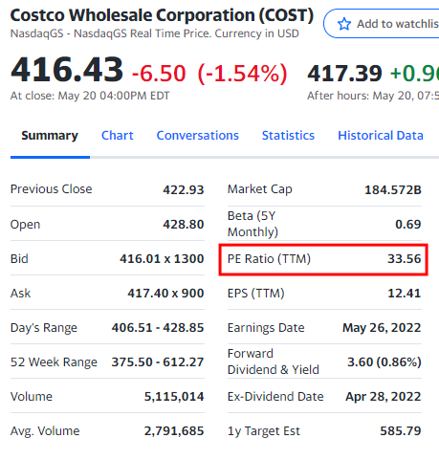
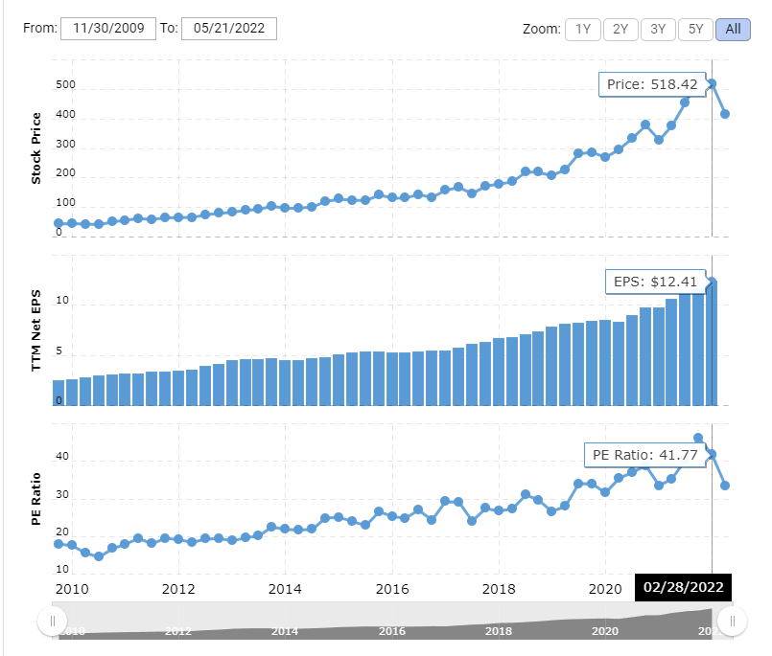
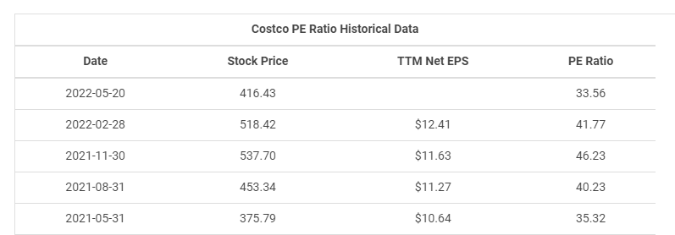
Stock Price and Net-income
Example - Costco
https://finance.yahoo.com/quote/COST?p=COST&.tsrc=fin-srch
https://www.macrotrends.net/stocks/charts/COST/costco/pe-ratio

Slide 25
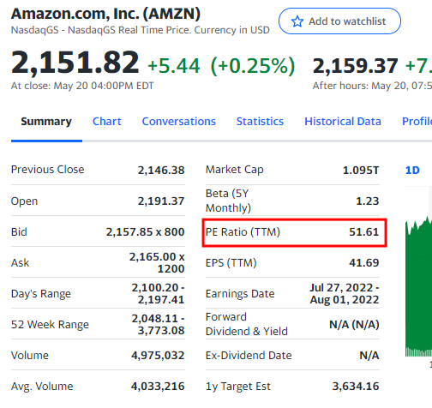
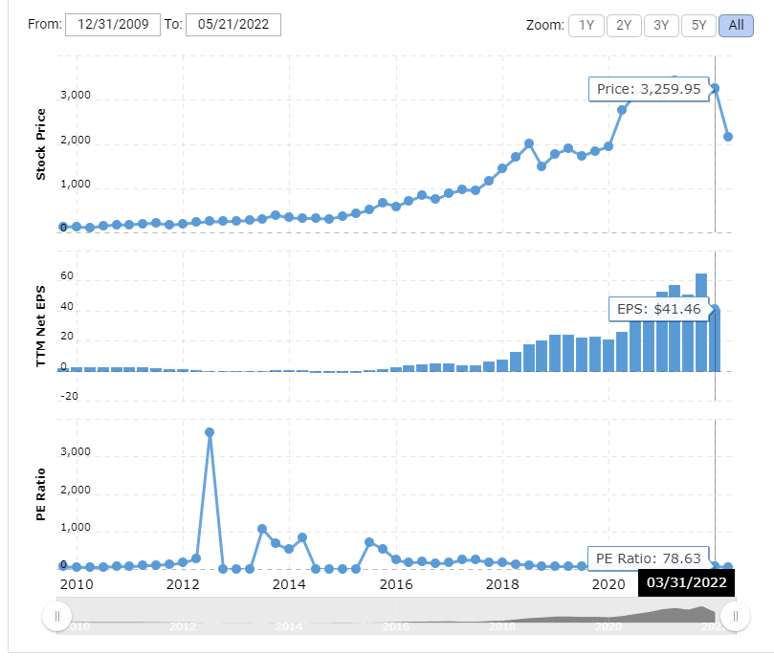
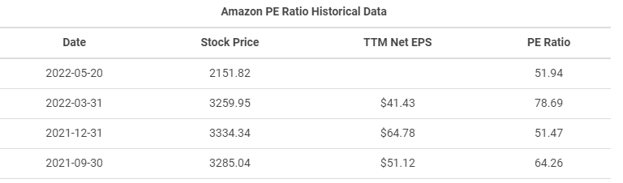
Stock Price and Net-income
Example - Amazon
https://finance.yahoo.com/quote/AMZN?p=AMZN&.tsrc=fin-srch
https://www.macrotrends.net/stocks/charts/AMZN/amazon/pe-ratio

Slide 26
Any Questions?

Slide 27
Auditor’s report
Four Types of Audit Opinion
- Unqualified Opinion (clean opinion)
- Qualified opinion
: Due to “material misstatements” or “unable to obtain audit evidence”
: The (potential) misstatements are material but not pervasive.
- Disclaimer of opinion
: Due to “unable to obtain audit evidence”
The (potential) misstatements are material and pervasive.
- Adverse opinion
: Due to “material misstatements”
The misstatements are material and pervasive.
https://www.sec.gov/Archives/edgar/data/0001326205/000118518510000790/indiaglobal10k033110.htm#28
https://www.iaasb.org/publications/2020-handbook-international-quality-control-auditing-review-other-assurance-and-related-services
https://www.ifac.org/system/files/publications/files/IAASB-2020-Handbook-Volume-1.pdf

Slide 28
Accounting Information and Decision Making
Accounting Information can be used for decision making.
Evaluating our expense structure
: Cost of goods, salary expense, advertisement, other expenses.
: Comparing with other companies
: Trend analysis (comparing with itself or other companies)
: Which business processes are needs to be improved (new IT Project)?
Business cycle evaluation and improvement
: Level of inventory, Level of accounts receivables, amount of PPEs
Deciding dividend policy
: Dividend or not dividend
Do we have enough cash?

Slide 29
Summary
Financial Ratio
- Profitability
- Debt Ratio
- Stock Price related Ratio
Auditor’s Report
Evaluating companies
Developing future strategy

Slide 30
Thank you!

